Slide 1
HTML and CSS

Slide 2
Introduction
Purpose
Provides an overview of HTML
Provides an overview of Style Sheet

Slide 3
Introduction
Objective
Candidate will be able to :
Understand the hierarchy of HTML elements
Create valid HTML Document with semantically correct
Use CSS to styling the web page
Create simple web layout with HTML and CSS

Slide 4
HTML

Slide 5
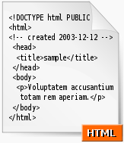
HTML
Hypertext Mark-up Language.
Major language of the Internet's World Wide Web.
NOT programming language.
Containing tags
MARKUP
Notes:
Not programming language, but markup language. Just to annotate how to structure & present content

Slide 6
HTML Code
<!doctype html>
<html>
<head>
<title>My Title</title>
</head>
<body>
<h1>My heading</h1>
<a href=“http://www.link.com”>My Link</a>
</body>
</html>
HTML TAG
Notes:
<!DOCTYPE HTML PUBLIC "-//W3C//DTD HTML 4.01//EN” "http://www.w3.org/TR/html4/strict.dtd">

Slide 7
HTML Markup – Tags/Elements
Surrounded by angle brackets.
Usually work in pairs.
<tagname>content</tagname>
But some work alone.
<tagname>
NOT case sensitive. But it is highly recommended to use LOWER CASE.
Notes:
The lower-case "requirement" is a legacy of xHTML, which explicitly required it (case sensitive). Some tag is uppercase <!DOCTYPE>
Plain old HTML on the other hand does not follow the rigid struct requirements of XML, and does not therefore have the fixed requirement for use of case
Now is just common convention (eg: browser dev tools displays tag in lower case).
It also easier to type and read

Slide 8
HTML Markup – Tags/Elements (Cont.)
<!DOCTYPE> | <ul> | <td> | <legend>
<html> | <li> | <a> | <span>
<head> | <ol> | <img> | <div>
<body> | <dl> | <blockquote>
<!--...--> | <dt> | <form>
<title> | <dd> | <label>
<meta> | <br> | <input>
<style> | <hr> | <textarea>
<link> | <strong> | <select>
<script> | <em> | <option>
<noscript> | <table> | <optgroup>
<h1> to <h6> | <th> | <button>
<p> | <tr> | <fieldset>
HTML Tags Complete Reference:
http://www.w3.org/TR/REC-html40/index/elements.html

Slide 9
HTML Markup – Attributes
Provides additional information about an element.
<tagname attribute=“value”>
E.g.: id, class, title, href, src, alt, type
Most attributes required a value
E.g. <input type=“checkbox” checked>
The quotes for value are optional
E.g. <input type=checkbox checked>
HTML 4.0 Attributes Reference: http://www.w3.org/TR/REC-html40/index/attributes.html

Slide 10
Comment
HTML Markup - Comment
Markup construction that permits authors to insert notes and remarks into html documents.
Comments are ignored when an html document is parsed or processed.
Example:
<!-- These extra divs/spans may be used as catch-alls to add extra imagery. -->
<div id="extraDiv1"><span></span></div>

Slide 11
HTML DTD
HTML Version
<!DOCTYPE HTML PUBLIC "-//W3C//DTD HTML 4.01//EN”
"http://www.w3.org/TR/html4/strict.dtd">
Document Type Definition reference path
Informs the validator which version of HTML that being used.
Essential to the proper rendering and functioning of web documents in compliant browsers.

Slide 12
HTML DTD (Cont.)
DOCTYPE | Explanation
STRICT: <!DOCTYPE HTML PUBLIC "-//W3C//DTD HTML 4.01//EN" "http://www.w3.org/TR/html4/strict.dtd"> | NOT INCLUDE deprecated elements & attr. Framesets are NOT ALLOWED.
TRANSITIONAL: <!DOCTYPE HTML PUBLIC "-//W3C//DTD HTML 4.01 Transitional//EN" "http://www.w3.org/TR/html4/loose.dtd"> | INCLUDE deprecated elements & attributes. Framesets are NOT ALLOWED.
FRAMESET: <!DOCTYPE HTML PUBLIC "-//W3C//DTD HTML 4.01 Frameset//EN" "http://www.w3.org/TR/html4/frameset.dtd"> | INCLUDE deprecated elements & attributes. Framesets are ALLOWED.
Deprecated Elements: <center>, <font>, <u>, <strike>
Deprecated Attributes: bgcolor, align, width, size
Framesets: part of web page which display & load content independent of its container.
Notes:
Frames
With frames, you can display more than one HTML document in the same browser window. Each HTML document is called a frame, and each frame is independent of the others.
The Frameset Tag
defines how to divide the window into frames
Example: Irfanview

Slide 13
XHTML
Extensible HTML
XHTML was developed to make HTML more extensible and increase interoperability with other data formats
Xhtml has far more stricter syntax than html. Based on XML.
Notes:
XML was still happening back then

Slide 14
XHTML - Syntax
Case-sensitive for element and attribute names, while HTML is not.
All elements must be closed, either by separate closing tag or using self closing syntax (e.g. <br/>)
Attribute minimization is not allowed.
Attribute’s value must be quoted.
Notes:
Well formed
<input name="name" type="checkbox" checked /> not valid
<input name="name" type="checkbox" checked="checked" />valid
XML does not support attribute minimization. Attribute-value pairs must be written in full. Attribute names such as compact and checked cannot occur in elements without their value being specified.

Slide 15
XHTML DTD
DOCTYPE | Explanation
STRICT: <!DOCTYPE html PUBLIC "-//W3C//DTD XHTML 1.0 Strict//EN" "http://www.w3.org/TR/xhtml1/DTD/xhtml1-strict.dtd"> | NOT INCLUDE deprecated elements & attributes. Framesets are NOT ALLOWED. The markup must also be written as WELL-FORMED XML.
TRANSITIONAL: <!DOCTYPE html PUBLIC "-//W3C//DTD XHTML 1.0 Transitional//EN" "http://www.w3.org/TR/xhtml1/DTD/xhtml1-transitional.dtd"> | INCLUDE deprecated elements & attributes. Framesets are NOT ALLOWED. The markup must also be written as WELL-FORMED XML.
FRAMESET: <!DOCTYPE html PUBLIC "-//W3C//DTD XHTML 1.0 Frameset//EN" "http://www.w3.org/TR/xhtml1/DTD/xhtml1-frameset.dtd"> | INCLUDE deprecated elements & attributes. Framesets are ALLOWED. The markup must also be written as WELL-FORMED XML.
Notes:
Challenge:
the production of invalid XHTML documents by some Web authors
the lack of web browser support (IE6)

Slide 16
HTML5
It is the fifth and current version of the HTML standard
Simpler DTD
<!doctype html>
New elements & attributes (removed some old)
New form controls
Better Multimedia capabilities (video, audio, canvas, webGL, SVG, etc)
And more APIs (storage, geolocation, etc)
Notes:
HTML5 offer simple Document Type. No versioning, no redundant information.
Advantages:
-Cleaner markup/ Improved code
-Elegant forms
-Consistency
-Supports rich media elements
-Offline Application Cache – app like
A lot of things that previously need to be done in 3rd party plugin, like flash, now is supported by web standards.
Eg: video player, games, vector graphic
HTML5 also defines standard for handling syntax error. So incorrect formed code can be displayed consistently across browsers.

Slide 17
New HTML5 Elements
Tag | Description
<article> | For complete or self-contained compositions such as a blog post or a widget
<aside> | For content aside from the content it is placed in. The aside content should be related to the surrounding content
<command> | A button, or a radiobutton, or a checkbox
<details> | For describing details about a document, or parts of a document
<summary> | A caption, or summary, inside the details element
<figure> | For grouping a section of stand-alone content, could be a video
<figcaption> | The caption of the figure section
<footer> | For a footer of a document or section, could include the name of the author, the date of the document, contact information, or copyright information
<header> | For an introduction of a document or section, could include navigation
<hgroup> | For a section of headings, using <h1> to <h6>, where the largest is the main heading of the section, and the others are sub-headings
<mark> | For text that should be highlighted
<meter> | For a measurement, used only if the maximum and minimum values are known
<nav> | For a section of navigation
<progress> | The state of a work in progress
<ruby> | For ruby annotation (Chinese notes or characters)
<rt> | For explanation of the ruby annotation
<rp> | What to show browsers that do not support the ruby element
<section> | For a section in a document.
<time> | For defining a time or a date, or both
Tag | Description
<audio> | For multimedia content, sounds, music or other audio streams
<video> | For video content, such as a movie clip or other video streams
<source> | For media resources for media elements, defined inside video/audio elements. Multiple source elements can link to different video/audio files. The browser will use the first recognized format.
<embed> | For embedded content, such as a plug-in

Slide 18

Format HTML Layout
HTML - Hierarchy of Elements
Notes:
Todo:add demo html and basic tag. Writing and output.use online tool or brackets

Slide 19
HTML – Basic Tag
<h1>,<h2>,…<h6> - heading
<p> paragraph
<br> single line break
<ul> Unordered list
<ol> Ordered list
<pre> preformatted
<a> anchor/link
<img> image
<blockquote> Quotation
Notes:
Demo: html-basic

Slide 20
HTML Table
Table is for displaying tabular data.
Structure
Caption <caption> - table title
Header <thead> - eg: column header
Body <tbody> - multiple rows presenting data
Footer <tfoot> - eg: totals, summary, etc
Row and columns
Table row <tr> - required in header, body, footer
Table header data <th> - defines a cell for data in header
Table data <td> - defines cell for data in body or footer
Spanning column or rows
Attributes: colspan/rowspan
Notes:
Demo:html-table
https://plnkr.co/edit/IMDW1s0bXgUinojaIGZq?p=preview

Slide 21
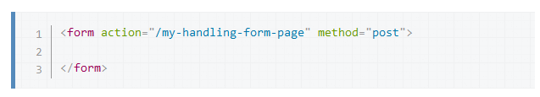
HTML Form
HTML Forms are one of the main points of interaction between a user and a web site or application.
An HTML Form is made of one or more widgets. Those widgets can be text fields (single line or multiline), select boxes, buttons, checkboxes, or radio buttons.
Notes:
The action attribute defines the location (URL) where the form's collected data should be sent when it is submitted.
The method attribute defines which HTTP method to send the data with (it can be "get" or "post").

Slide 22
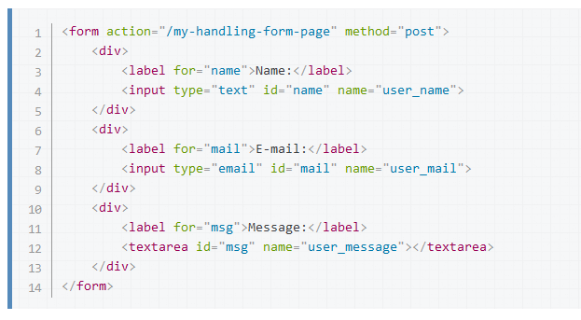
Notes:
demo:html-formbasic
https://plnkr.co/edit/lh9c5vzhrWmWbynQ8oxo?p=preview

Slide 23
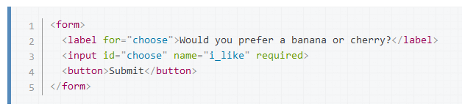
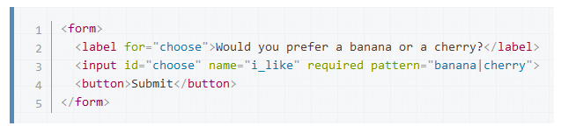
HTML5 Form Validation
One of the features of HTML5 is the ability to validate most user data without relying on scripts.
The required attribute
Validating against a regular expression
Constraining the length of your entries
Notes:
Demo:html-formvalidation
https://developer.mozilla.org/en-US/docs/Learn/HTML/Forms
https://plnkr.co/edit/kmJSMI0qJpMSRcg05tPD?p=preview

Slide 24
HTML Entity
HTML entity is a string used to represent a character.
begins with the ' &' character and ends with the ' ;‘
Example
Character | Entity | Note
& | &amp; | Ampersand character interpreted as the beginning of an entity.
< | &lt; | Less-than character interpreted as the beginning of a tag
> | &gt; | Greater-than character interpreted as the ending of a tag
" | &quot; | Double-quote character interpreted as the beginning and end of an attribute value.

Slide 25
Semantic HTML
Semantic HTML is the use of HTML markup to reinforce the semantics, or meaning, of the information in webpages and web applications rather than merely to define its presentation or look.

Slide 26

HTML Semantics
Example :
Use headings for the title
<h1>Solutions to enhance your bottom line</h1>
Use Paragraph if it is a paragraph
<p>When you outsource….</p>
<p>So Mitrais bidding methodology....</p>
<p>And the Mitrais….</p>

Slide 27

HTML Semantics (Cont.)
Example 2 :
Navigation is a list of links
<nav>
<ul>
<li>Home</li>
<li>
Solutions
<ul>
<li>Solutions</li>
<li>.Net Solutions</li>
</ul>
</li>
</ul>
</nav>

Slide 28
(Web Design) Tableless Layout
Table is not for layout purpose
Use <div> instead (or other relevant html5 tags) to make layout divisions

Slide 29
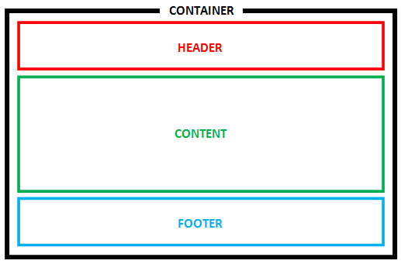
(Web Design) Tableless Layout (Cont.)
<div id=“container”>
<div id=“header”></div>
<div id=“content”></div>
<div id=“footer”></div>
</div>
<div id=“container”>
<header id=“header”></header>
<section id=“content”></section>
<footer id=“footer”></footer>
</div>

Slide 30
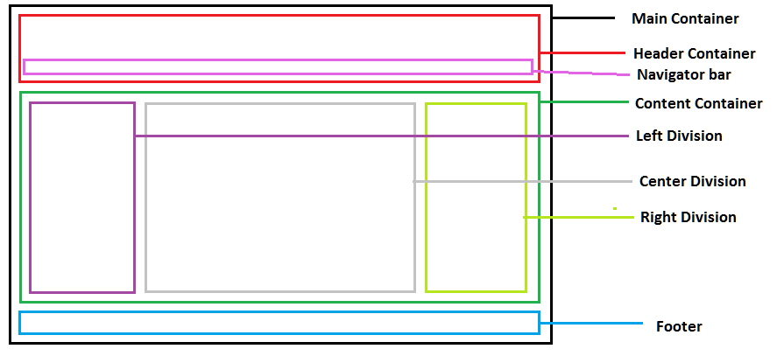
(Web Design) Tableless Layout (Cont.)

Slide 31
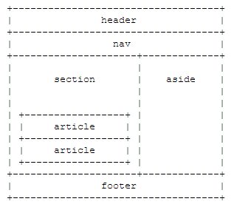
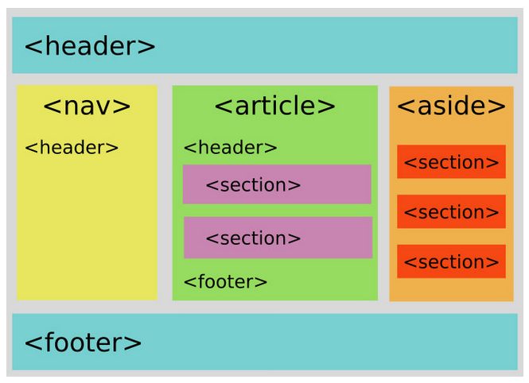
HTML5 Another Layout Examples
Notes:
demo:html-layout
https://plnkr.co/edit/Lv0JVlnvnAvrnm501tTh?p=preview

Slide 32
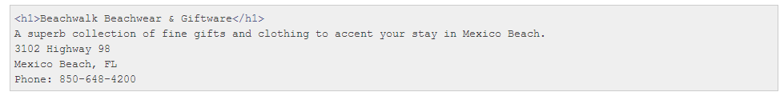
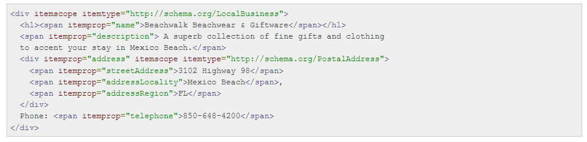
HTML5 Microdata
Even more semantic
Microdata is a specification used to nest metadata within existing content on web pages.
Search engines, web crawlers, and browsers can extract and process microdata from a web page and use it to provide a richer browsing experience for users.
Notes:
Both human and machinecan interpret it

Slide 33
Microdata (cont)
microdata consists of a group of name-value pairs. The groups are called items, and each name-value pair is a property.
Google and other major search engines support the Schema.org vocabulary for structured data.
This vocabulary defines a standard set of type names and property names
Example:
http://schema.org/Product
http://schema.org/Organization
Notes:
Demo:html-microdata
https://plnkr.co/edit/92WyZJwdC1AmgG9oxN1Z?p=preview

Slide 34
CSS

Slide 35
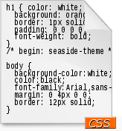

CSS
Cascading Style Sheets.
Used to describe the presentation semantics (that is, the look and formatting)
Control the rendering format of a Web document without compromising its structure.
Is designed to enable the separation of presentational aspect of document from its content.

Slide 36
CSS Code
Selector
Declaration Block
Declaration
Declaration
Property
Value
Property
Value
body { color: black; padding: 1em; }
<body style=“color: black; padding: 1em;”>

Slide 37
CSS - Selector
* | any element
E | an element of type E
E F | an F element descendant of an E element
E#myid | an E element with ID equal to "myid".
E.myclass | an E element whose class is “myclass".
E[foo] | an E element with a "foo" attribute
E[foo="bar"] | an E element whose "foo" attribute value is exactly equal to "bar"
E:hover | an E element during certain user actions
E:active
E:focus
E:first-child | an E element, first child of its parent
E::first-line | the first formatted line of an E element
E::first-letter | the first formatted letter of an E element
E > F | an F element child of an E element
E + F | an F element immediately preceded by an E element

Slide 38
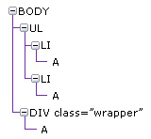
CSS – Selector (Cont.)
A {}
LI A {}
.wrapper {}
.wrapper A {}

Slide 39
CSS - Property
Background
background-color: black;
Text
text-color, text-align, text-decoration, text-indent
Font
Font-family, font-size, font-weight, font-style
Positioning
position: absolute/relative/fixed;
Floating
float: left/right/none;
Others
padding, margin, border, display, width, height

Slide 40
CSS - Resources
CSS Complete reference:
http://www.w3.org/Style/CSS/
http://www.w3.org/TR/css3-selectors/
https://developer.mozilla.org/en-US/docs/Web/CSS

Slide 41
CSS - Comment
Example:
/* Body Styles */
body {
font-size: 67.5%;
/* Set the font size */
}

Slide 42
CSS – Applying the Style
Using “style attribute” in element (inline)
<p style=“color: blue;”>This is blue</p>
Using “style tag” (internal)
<html>
<head>
<!–- internal -->
<style type=“text/css”>
p { color: blue; }
</style>
<!– external -->
<style type=“text/css”>
@import url "import2.css";
</style>
</head>
</html>

Slide 43
CSS – Applying the Style (Cont.)
Using “link tag” (external)
<html>
<head>
<link href=“main.css"
rel="stylesheet"
type="text/css" />
</head>
</html>
Notes:
Which one is better?
-Separation of concern is better.

Slide 44
CSS – Specificity Hierarchy
Inline styles
ID
Classes, Attributes, and Pseudo-classes
Elements

Slide 45
CSS – Specificity Hierarchy (Cont.)
Example:
<style type="text/css">
a#link { color: aqua; }
#link { color: red; }
a[title="link"] { color: yellow; }
a:link { color: black; }
a.link { color: orange; }
.link { color: purple; }
a { color: pink; }
</style>
<div id="wrapper">
<a href="#" class="link" id="link" title="link" style="color: green;">my link</a>
</div>
Notes:
Demo:css-specificity

Slide 46
CSS – Cascade
Used to determine which declaration to apply when multiple declaration is applied to the same element.
The Process:
Find all declarations that apply to a specific element.
Sort the declarations according to their level of importance and origins.
Sort declarations with the same level of importance and origin by selector specificity.
If declarations have the same level of importance, origin, and specificity. Sort them by the order in which they’re specified. The last declaration wins.

Slide 47
CSS – Cascade (Cont.)
Used to add weight to a declaration.
p { font-size: 10px !important; }
The cascade works in the following order of importance:
User styles flagged as !important
Author styles flagged as !important
Author styles
User styles
Browser default/user agent styles

Slide 48
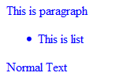
CSS - Inheritance
For instance, if you were to give the body element a text color of blue, all the descendants of the body element would also have blue text, unless another style is defined for another element.
<html>
<head>
<style type=“text/css”>
body { color: blue; }
</style>
</head>
<body>
<p>This is paragraph</p>
<ul><li>This is list</li></ul>
Normal Text
</body>
</html>
Notes:
Demo: css-inheritance

Slide 49
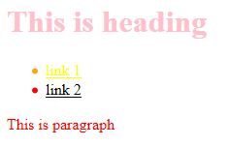
CSS – Code Sample
Example:
<style type="text/css">
* { color: red; }
#wrapper { color: black; }
h1 { color: pink; }
.imp { color: black; }
a { color: yellow; }
#menu .active { color: orange; }
</style>
<div id="wrapper">
<h1>This is heading</h1>
<ul id="menu">
<li class="active"><a href="#">link 1</a></li>
<li><a href="#" class="imp">link 2</a></li>
</ul>
<p>This is paragraph</p>
</div>

Slide 50
typography
Font-face
Custom font files (eg: .ttf, .svg, .eot)
Different browser, different supported format
Google fonts
https://fonts.google.com/
@font-face {
font-family: 'MyWebFont';
src: url('webfont.eot'); /* IE9 Compat Modes */
src: url('webfont.eot?#iefix') format('embedded-opentype'), /* IE6-IE8 */
url('webfont.woff2') format('woff2'), /* Super Modern Browsers */
url('webfont.woff') format('woff'), /* Pretty Modern Browsers */
url('webfont.ttf') format('truetype'), /* Safari, Android, iOS */
url('webfont.svg#svgFontName') format('svg'); /* Legacy iOS */
}
Notes:
Demo:css-typography
Demo:css-typography2
Previously we have to use Flash (eg: siFR) or image replacement technique

Slide 51
Media queries and Responsive Design
CSS conditional rules that apply based on media
Responsive web apps use technologies like media queries and viewport to make sure that their UIs will fit any form factor: desktop, mobile, tablet, or whatever comes next.
@media <media-query-list> {
<group-rule-body>
}
Notes:
Demo:css-media
Demo:css-responsive-design

Slide 52
Debugging using dev tools
Firebug
Firefox Developer tools
Opera Dragonfly
Chrome Dev tools
IE’s F12 Developer Tools

Slide 53
CSS Library and Framework
CSS reset, Blueprint, 960
Bootstrap, Foundation, semantic UI, UIKit, etc

Slide 54
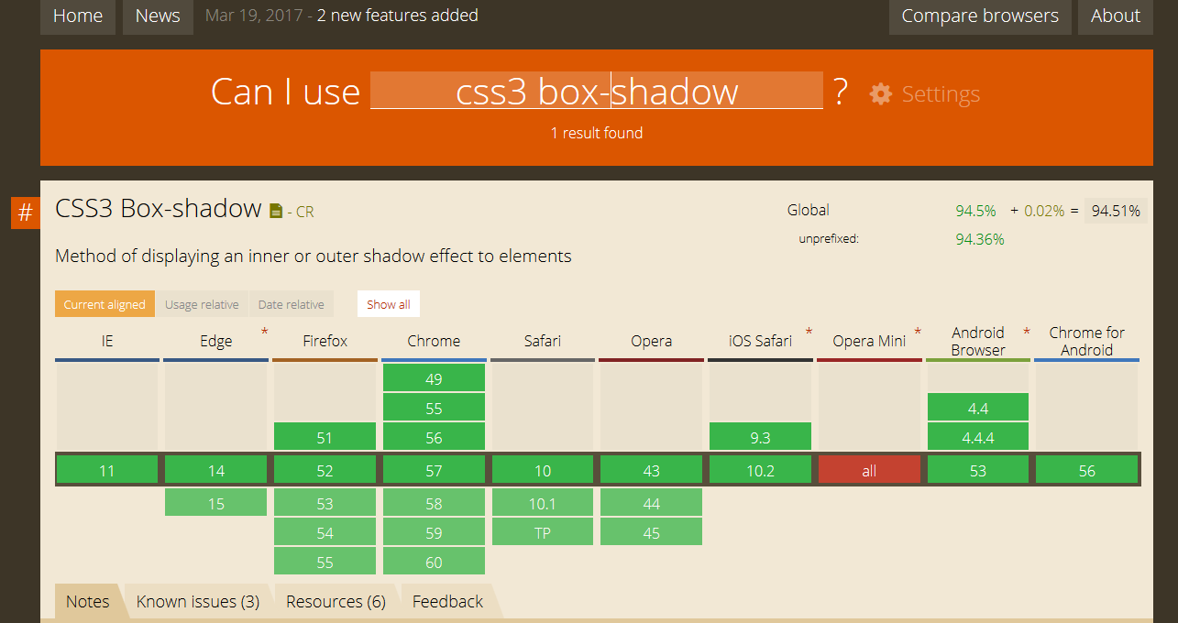
Cross Browser Compatibility
Use Caniuse.com as reference
Use Virtual machine to test old browser/different platform
Use mobile emulator
Online services like browserstack

Slide 55
THANK YOU

